Slide 1
Computer Graphics Models
László Szécsi szecsi@iit.bme.hu
AIT

Slide 2
Game objects and model geometries
GameObject
Mesh
Material
vertex shader
fragment shader
modellmátrix
Geometry
*
vertex buffer
uniform setting
index buffer
texture

Slide 3
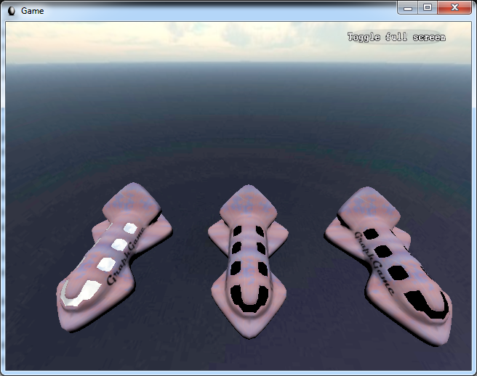
Submesh

Slide 4
Game objects and model geometries
GameObject
Mesh
Material
vertex shader
fragment shader
modellmátrix
SubMeshGeometry
vertex buffer
QuadGeometry
*
uniform setting
index buffer
texture

Slide 5
JSON model file format
designed for WebGL
easy to load from Kotlin
contains data in ready-to-use-in-buffers format
download model from Moodle
or convert your own using Blender
see the Blender slides and video
use the script on Moodle

Slide 6
Geometry loaded from file
create new SubmeshGeometry.kt similar to TexturedQuadGeometry.kt
constructor takes an object, describing a mesh as loaded from JSON file, having the properties:
property vertices: 3n coordinates in continuous array
property normals: 3n elements in continuous array
property texturecoords: array (typically with a single element, as the model has only one set of texture coordinates) of continuous arrays of 2n elements
property faces: array of n arrays of 3 indices
make continuous (and proper 16-bit int type) array using
val indexIterator = jsonMesh.faces.flatten().iterator()
val indexArray = Array<Short>(indexCount) {indexIterator.next()}
texturecoords[0]
the expressions in red replace array literals
but wrapping them in typed arrays must remain

Slide 7
Geomety from JSON
jsonMesh.vertices
jsonMesh.normals
jsonMesh.texturecoords[0]
these replace array literals
gl.bindBuffer(GL.ARRAY_BUFFER, vertexBuffer)
gl.bufferData(GL.ARRAY_BUFFER,
Float32Array(arrayOf<Float>(
-1.0f, -1.0f, 0.5f,
-1.0f, 1.0f, 0.5f,
1.0f, -1.0f, 0.5f,
1.0f, 1.0f, 0.5f
)),
GL.STATIC_DRAW)

Slide 8

Index buffer
flattened array
We need this in the draw method
val indexBuffer = gl.createBuffer()
val indexCount = jsonMesh.faces.flatten().size
init{
val indexIterator = jsonMesh.faces.flatten().iterator()
val indexArray =
Array<Short>(indexCount) {indexIterator.next()}
gl.bindBuffer(GL.ELEMENT_ARRAY_BUFFER, indexBuffer)
gl.bufferData(GL.ELEMENT_ARRAY_BUFFER,
Uint16Array( indexArray ),
GL.STATIC_DRAW)
}
Short array to make a Uint16Array

Slide 9
JsonLoader.kt
import org.w3c.xhr.XMLHttpRequest
import org.w3c.dom.events.*
import kotlinx.serialization.*
import kotlinx.serialization.json.*
import vision.gears.webglmath.Geometry
@Serializable
data class JsonMesh(
val vertices : Array<Float>,
val normals : Array<Float>,
val texturecoords : Array<Array<Float>>,
val faces : Array<Array<Short>>)
@Serializable
data class JsonModel(
val meshes : Array<JsonMesh>)

Slide 10
JsonLoader.kt
from this string
fun loadGeometries(gl : WebGL2RenderingContext,
jsonModelFileUrl : String) : Array<Geometry> {
val request = XMLHttpRequest()
request.overrideMimeType("application/json")
request.open("GET", jsonModelFileUrl, false)
var geometries : Array<Geometry>? = null
request.onloadend = {
val json = Json { ignoreUnknownKeys=true }
val jsonModel = json.decodeFromString(
JsonModel.serializer(), request.responseText)
geometries = jsonModel.meshes.map{ SubmeshGeometry(gl, it) }.toTypedArray()
Unit
}
request.send()
return geometries!!
}
make these
create a list
mesh geometry as given in the JSON object

Slide 11
JsonLoader.kt
fun loadMeshes(
gl : WebGL2RenderingContext,
jsonModelFileUrl : String,
vararg materials : Material) : Array<Mesh>{
val geometries = loadGeometries(gl, jsonModelFileUrl)
return (materials zip geometries).map{(m, g) -> Mesh(m, g)}.toTypedArray()
}
from this string
make these
pair up materials and geometries
create a mesh for each pair

Slide 12
GameObject.kt – multiple meshes are allowed as child components
open class GameObject(
vararg val meshes : Mesh
) : UniformProvider("gameObject") {

Slide 13
Use this to display 3D object
create materials for both submeshes
same program, different texture
create game object using multiple meshes
val jsonLoader = JsonLoader()
val slowpokeMeshes = jsonLoader.meshesFrom(gl,
"media/slowpoke/slowpoke.json",
Material(texturedProgram).apply{
this["colorTexture"]?.set(
Texture2D(gl, "media/slowpoke/YadonDh.png"))
},
Material(texturedProgram).apply{
this["colorTexture"]?.set(
Texture2D(gl, "media/slowpoke/YadonEyeDh.png"))
}
)
init{
gameObjects += GameObject(*slowpokeMeshes)
}

Slide 14
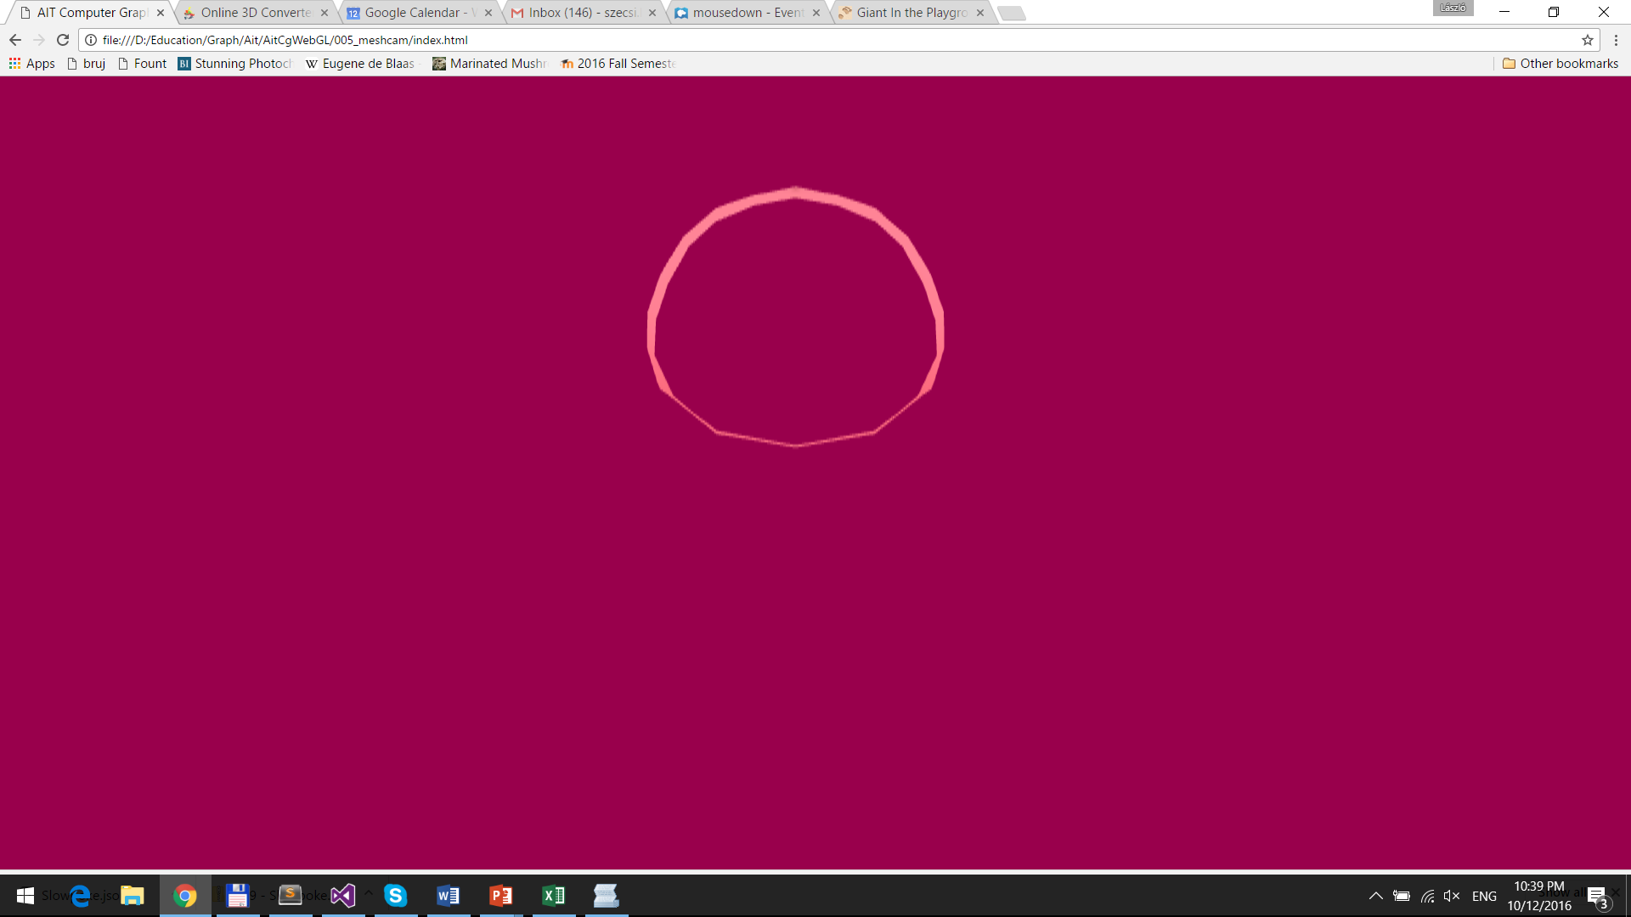
Part of object that coincides with visible area shown (your camera may be different)

Slide 15
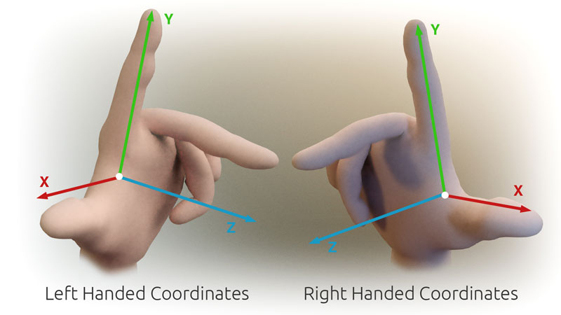
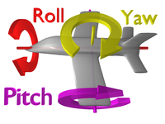
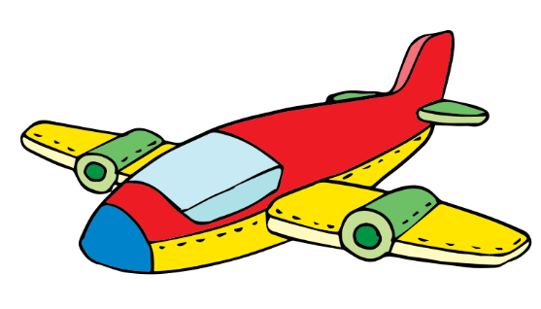
Yaw-pitch-roll: a way to specify 3D orientation
right-handed coordinates
main directions
x: right
y: up
z: back (ahead is -z)
rotation angles:
yaw – around y
pitch – around x
roll – around z
y
x
z

Slide 16
3D rotation in GameObject
modelMatrix.set().
scale(scale).
rotate(roll).
rotate(pitch, 1.0f, 0.0f, 0.0f).
rotate(yaw, 0.0f, 1.0f, 0.0f).
translate(position)
properties roll, pitch, yaw replace orientation
in GameObject#update

Slide 17
Make object fully visible
set game object scale (approx. 0.1, 0.1, 0.1)
rotate (e.g. half π around the vertical axis)
enable depth testing to avoid further away parts showing through
gl.enable(GL.DEPTH_TEST)
avoid transparency
either disable alpha blending
or make sure your fragment shaders sets unit alpha

